Slide 1
AY250 Final Project
Francine Foo
Dec 12, 2013

Slide 2
Project Proposal
Create a pipeline for the pre-processing and analysis of ECoG (Electrocorticography) data
Lecture themes used: GUIs, pandas, some tools from matplotlib and scipy

Slide 3
What I do with ECoG
My experimental task: patient passively listens to consonant and dissonant chords with some distractor sounds thrown in the mix
Goal of study: investigate if there is differential activation of electrode sites in the superior temporal gyrus in response to consonant and dissonant chords

Slide 4
Pipeline
Step 1: enter global information of dataset
- patient code, task name, sampling rate, analog sampling rate, number of electrodes
Step 2: load and view the analog speaker file
Step 3: find auditory events from speaker file
- mark the onset and offset times of the stimuli
Step 4: load and view the electrode channels
- Identify bad electrodes and ictal epochs
Step 5: common average reference (CAR)

Slide 5
Pipeline
Step 6: generate spectrograms for each electrode
Step 7: create events dataframe
- assemble a data structure containing the stimulus name, stimulus type (chord vs. distractor sound), onset time, offset time, whether it is a bad event (coincides with an ictal epoch)
Step 8: create surrogate data for statistical analysis (incomplete)
Step 9: create analysis event-related spectral perturbations (ERSPs) using the surrogate data (incomplete)
Step 10: plot ERSPs for each electrode (incomplete)

Slide 6
Files in package
iPython Notebook
- Final Project.ipynb
.py scripts
- ecog_gui.py
- find_aud_evs.py
- CAR.py
- create_spect.py
data files
- gdat.mat: the file containing the ECoG dataset (WARNING: BIG FILE! but it's already the smallest dataset that I have)
- spkr.mat: the file containing the speaker file that contains a record of the stimuli played during the experiment (musical chords in my case)
- CP5_passive_block2.xls: the file containing a list of the names of the stimuli in the order that they were played

Slide 7
Step 1: run ecog_gui.py in ipython

Slide 8
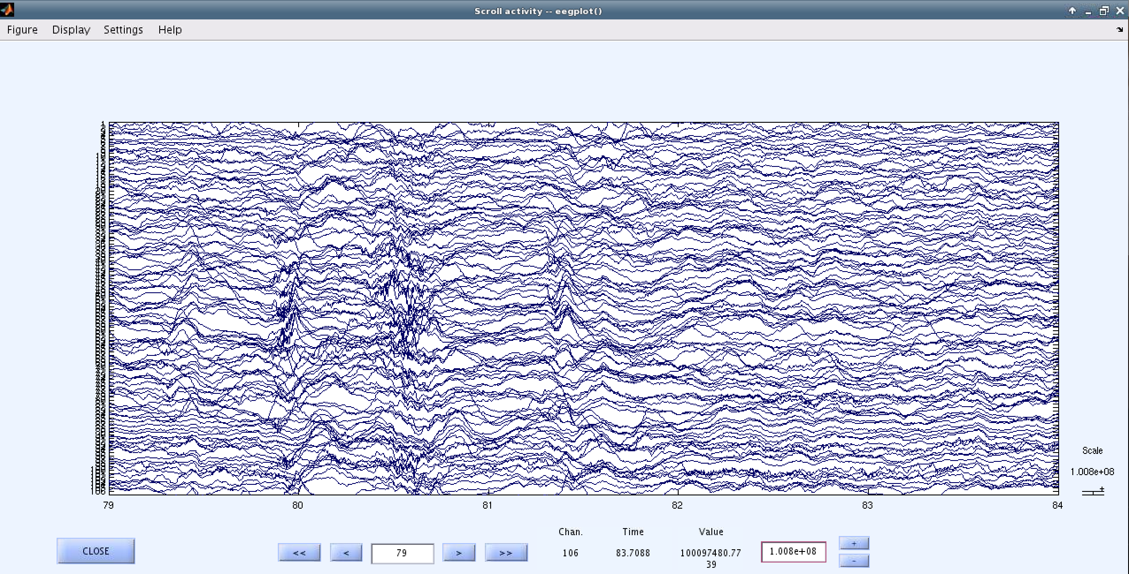
This is what I originally wanted to re-create in python as a GUI…
EEGplot in matlab

Slide 9
Specific uses of EEGplot
User loads in entire ECoG dataset
Able to visualize all the electrode channels at one go in order to manually identify bad electrodes and ictal epochs
User can adjust the number of channels to display, as well as the length of data to display (e.g. show 5 seconds of it at one time, and allow the user to scroll through the dataset in 5-second blocks)

Slide 10
But that proved a little too difficult to re-create given the time limit of this project, so this is what I have: in ipython: run ecog_gui.py

Slide 11
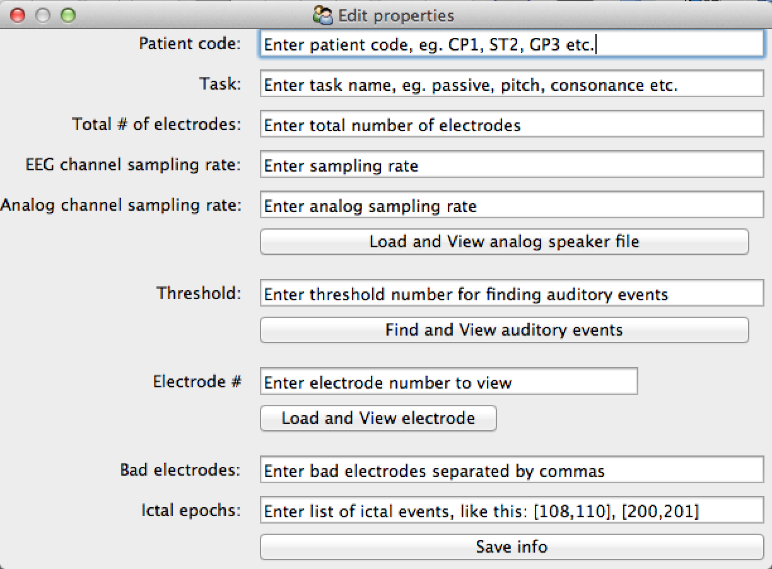
My GUI

Slide 12
One major problem:
I upgraded my Mac OS system after completing the homework on GUIs, so I started having problems with visualizing figures within the GUI using Traits.
However, clicking the “load and view” buttons still produces the figures, albeit outside the GUI box and you’d have to wait a while for them to appear, so it looks like the computer is hanging but it’s not!

Slide 13
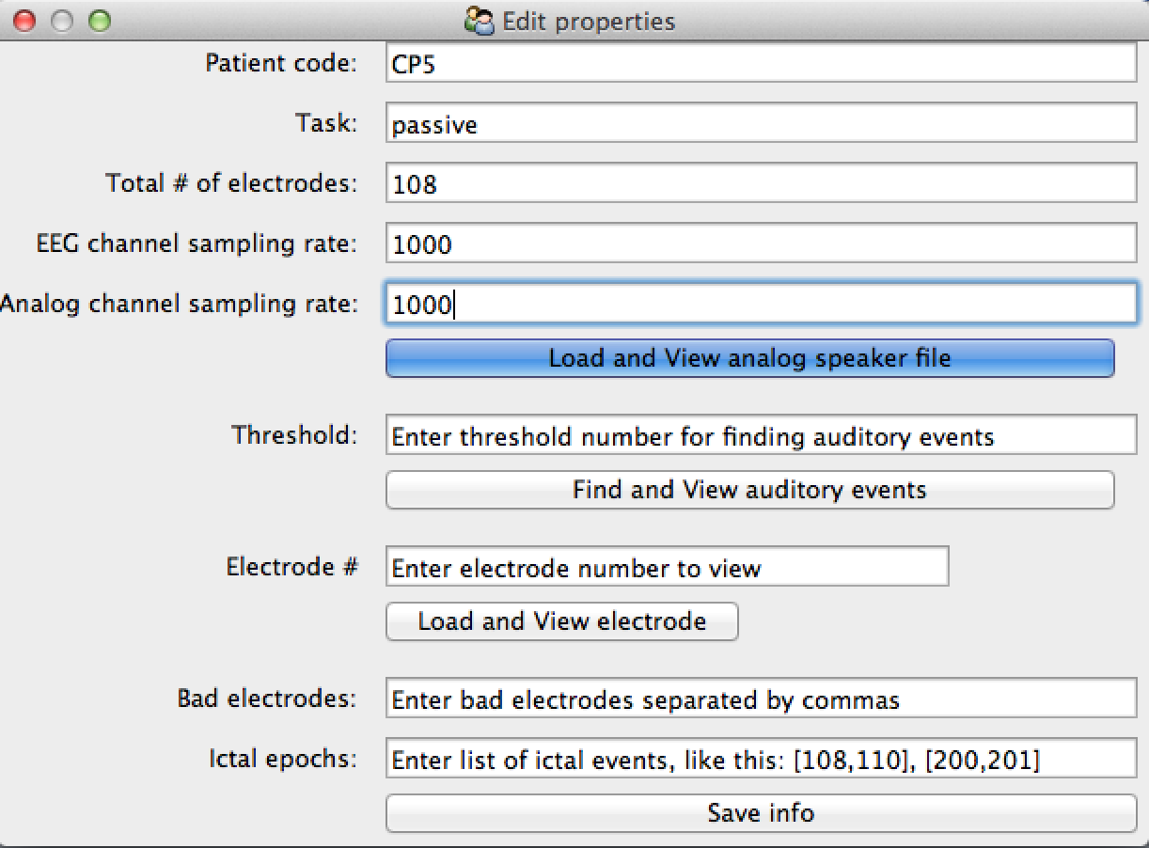

Slide 14
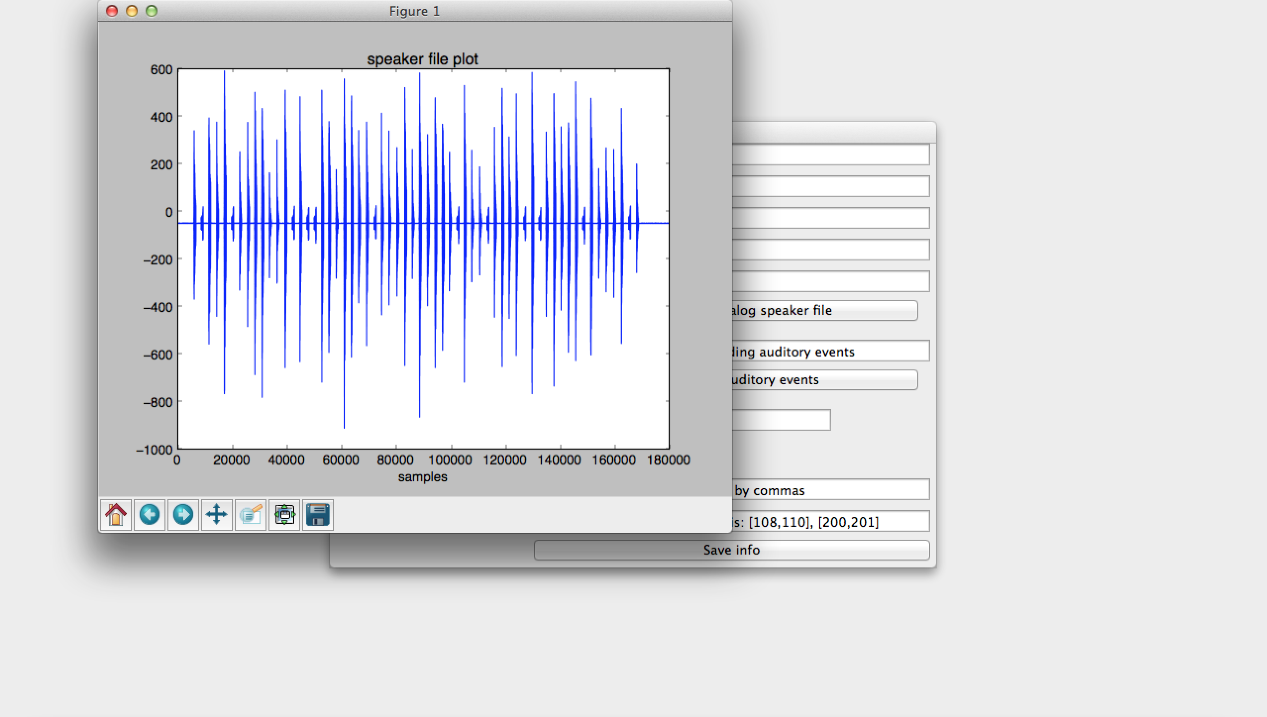
After a while…

Slide 15
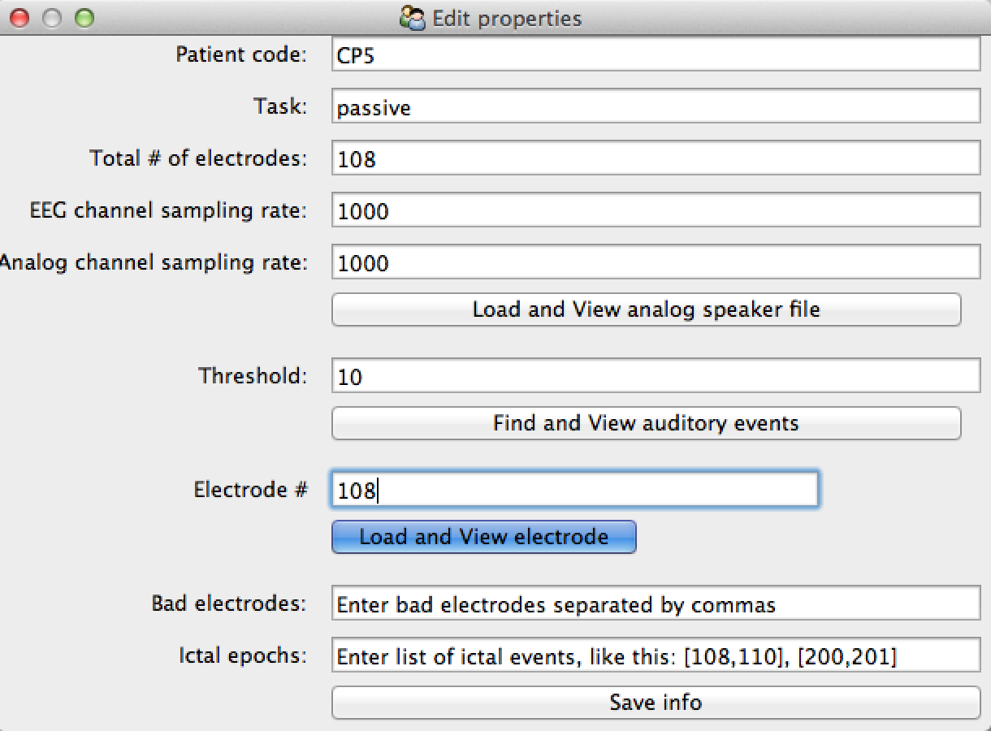

Slide 16
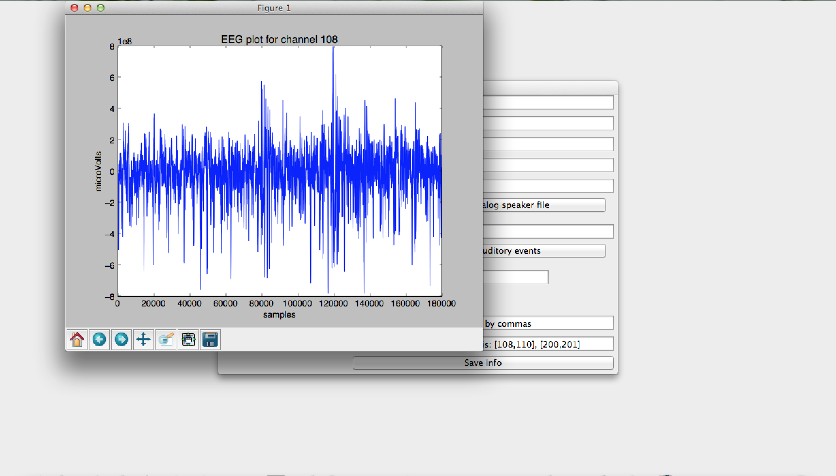
After a while…
A very simplified version. This should ideally be like EEGplot where the user can view not 1 electrode but all if he chooses, and over a certain specified period of time (say 5 seconds, not the entire file like this which has the signal smushed up)

Slide 17
Other problems that I did not manage to fix/finish:
Find and view auditory events button
The plot works fine, but the vertical lines marking the onset and offset of the stimuli are not showing up. I used the same code in the ipython notebook (Final Project.ipynb), and it shows up fine there. Not sure why this is so.
Save info button
My goal was, after finding auditory events and viewing the electrode channels to identify bad channels and ictal epochs, to save all relevant information by saving all variables into a file (matlab style), and then importing this file of variables into ipython notebook to continue the analysis, but I did not manage to finish this. It could be easily done by writing all the important variables into a .txt file, and then import and read the .txt file in ipython notebook.

Slide 18
Step 2: open Final Project.ipynb

Slide 19
All the stuff in the GUI script can be found in the notebook too
They take the form of Steps 1-4 of the pipeline. Somehow the find auditory events works fine in the ipython notebook but not in the GUI, even with the same code.
The rest of the notebook contains code up to Step 7.
Step 5: calculates the common average reference and subtracts it from all electrodes – calls a script CAR.py which does the calculation and returns the dataset with the CAR subtracted from it (works well)

Slide 20
Next problem (sorry, this project is full of problems…):
My code for Step 6 is currently broken: one of the functions in the script (my_hilbert) breaks within the loop. I have found the source of the problem and tried fixing it but could not finish fixing it in time. This step directly affects the code for Steps 8-10, hence this is why they are incomplete.

Slide 21
Step 7
Takes the list of onset and offset times calculated in Step 3 (find auditory events) and associates them with the stimuli names and types using a pandas dataframe. It also marks the events that are bad (e.g. occurred within an ictal epoch), and allows me to sort and select the stimuli and times based on different criteria.
The example I presented here is the simplest example of my tasks, mainly because the data file is small in size and can be pushed into the git repo. I have a much more complicated task where the patient has to respond “up”, “down”, “consonant” or “dissonant”, so there would be extra columns denoting the response type, the accuracy and the speed of response. The data file for this example is unfortunately too big to submit, so I’m trying to describe the uses of pandas dataframes in this step in order to select the appropriate list of onsets and offsets times to be used to generate and plot the event-related spectral perturbations (Steps 9-10) (e.g. correct ‘up’ responses that are not bad events and were answered within 1 second post-stimulus).

Slide 22
Steps 8-10 incomplete
Mainly because Step 6 had a bug and I ran out of time trying to fix Step 6..

Slide 23
That’s all I have!
Thanks for bothering to plough through my slides ☺

